Slide 1


Team Rocket
Devon Hubert, Shayan Shaikh, Sebastian Park,
Guadalupe Jimenez Mejia, Sharon Wong
12/2/2019

Slide 2
Application Domain
Plan-it creates an activity plan that will fit the user’s time and budget.
If users dislike the plan, they can simply generate a new one!
Motivations:
Not knowing how to spend free time
Wanting to know the options available when sticking to a budget

Slide 3
Goals
Allow users to generate a plan, given time and cost
Let users add and edit activities in the database
Let users specify the following attributes for each activity:
Activity Name
Max Time - how long activity could last
Ideal Time - how long activity should last
Max Cost - max expected cost of activity
Activity Type (food, games, outdoor, fitness, music, etc.)
Allow users to save their plan as a PDF

Slide 4
Challenges:
Learning how to use new technologies and APIs
Avoiding merge conflicts when using github
Accomplishments:
Successfully able to generate a random plan that will be able to take to your time and money into consideration
Successfully converted project into a maven project - this allowed for the use of many useful APIs. Example - importing the iText feature to save a plan as a pdf. Importing jUnit testing to easily create and run tests.

Slide 5
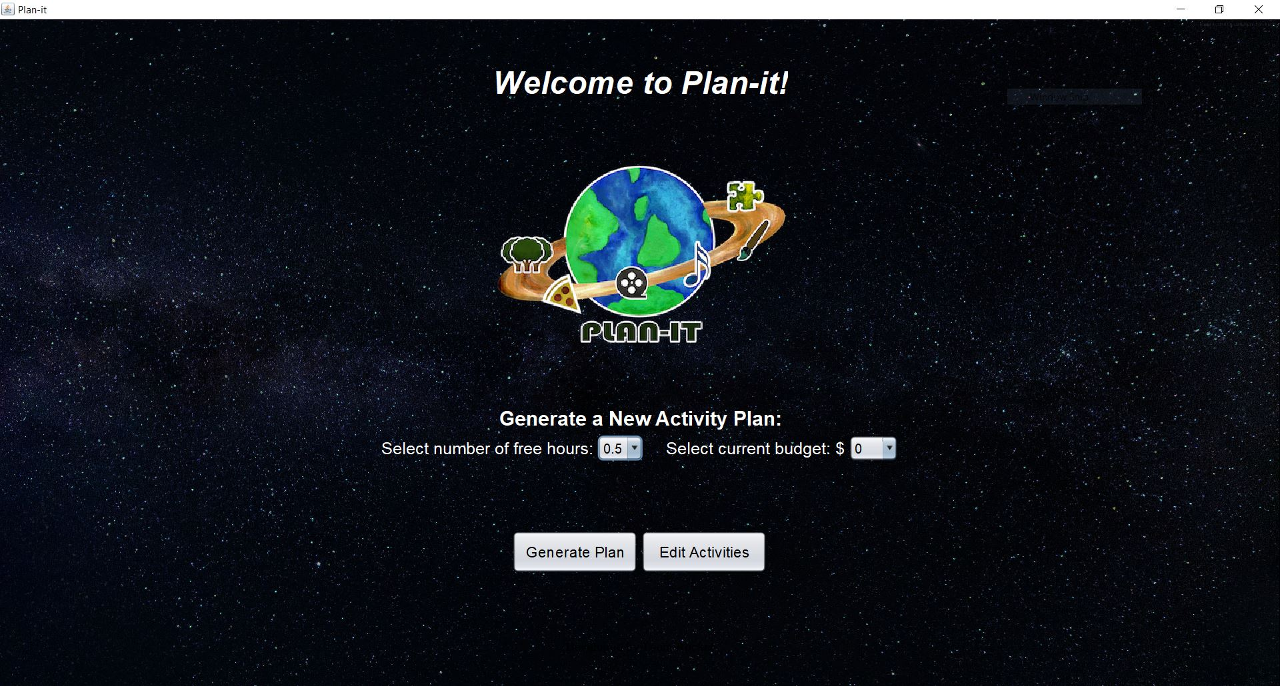
System Screenshots:

Slide 6
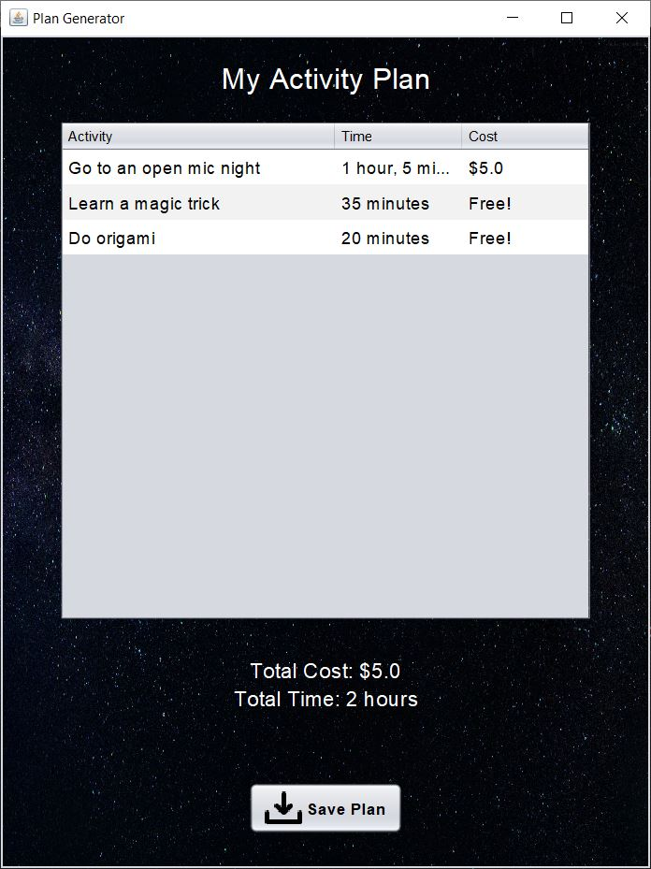
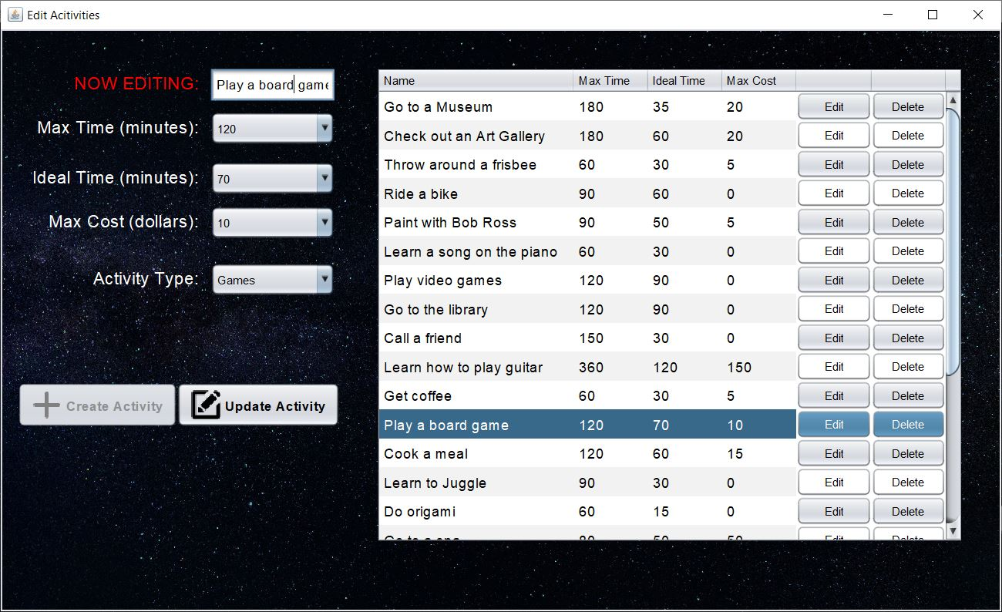
System Screenshots: (cont.)

Slide 7
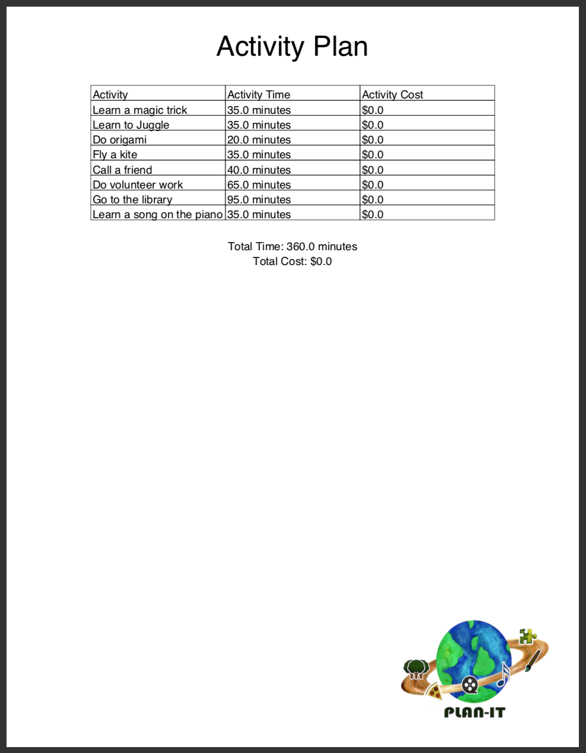
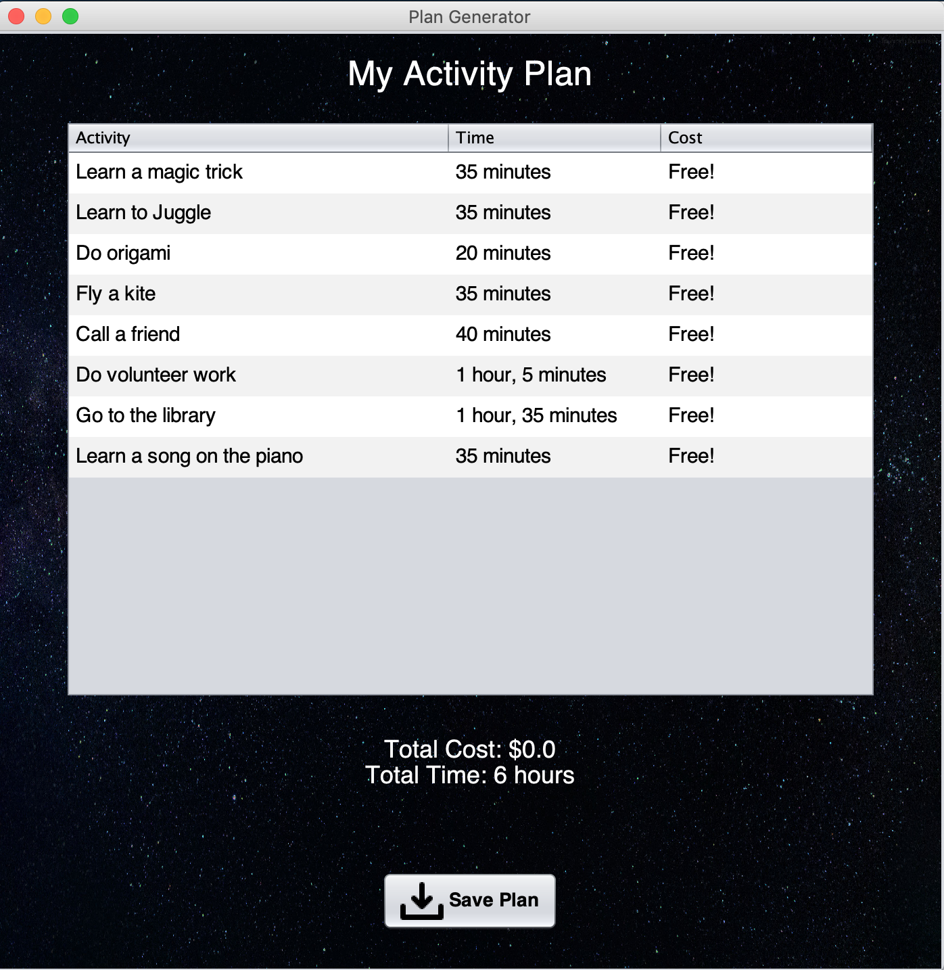
System Screenshots: (cont.)

Slide 8
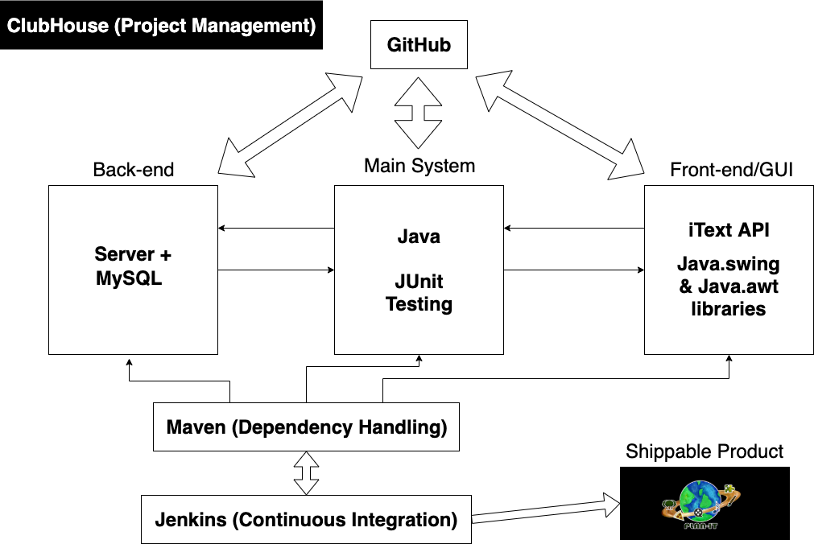
Technologies Used:

Slide 9
Project Management Techniques
Scrum
Used ClubHouse to assign and keep track of tasks for each sprint (virtual scrum board)
Met three times a week
Communicated via text group chat
Used GitHub for version control
Used Jenkins for Continuous Integration

Slide 10
What we enjoyed:
Implementing new technologies
Seeing the project come together
Learning tools that make implementing new features more manageable
What we didn’t enjoy:
Unexpected bugs
New technology spikes (e.g: Maven file for dependencies, iText for pdf generation, MySQL for our database)
Java running differently on different operating systems

Slide 11
Lessons Learned
What worked:
Meeting at scheduled times for Scrum meetings
Communicating via group chat
Constantly pulling from GitHub repo
What didn’t work:
Assigning tasks through spreadsheets (stopped after Sprint 1)
Things we wish we had done:
Started documenting our tests earlier
Learned about ClubHouse earlier

